Slide 1
Java Programming
152-130 Module 1

Slide 2

Getting Started w/
section 1.0

Slide 3
Getting Started w/
Open IntelliJ
File > New > Project
Ensure Java is chosen as the project type and click Next
Check Create project from template with Command Line App highlighted and click Next
Type Module1 for the Project Name
Type edu.wctc for the Base Package

Slide 4
Getting Started w/
In the Project sidebar dock, expand the Module1 folder and the src folder
Double click on the Main class file to open your newly created class
Remove the write your code here comment

Slide 5
Getting Started w/
If the Create project from template option wasn't available
Right click on the src folder and choose New > Java Class
Name your new class Main
Add your main method declaration

Slide 6
Shortcuts
If the Project sidebar dock isn't visible
ShortKey: Alt + 1
If your main method declaration is missing
ShortKey: type psvm inside the class declaration and press either Tab or Enter
Getting Started

Slide 7
Getting Started w/
To run your project
With the Main class open, press the green arrow to open the Run console dock
ShortKey: Shift + F10

Slide 8
Shortcuts
To format your code to include proper indentation
ShortKey: Ctrl + Alt + L
Format Your Code

Slide 9
Syntax
Section 1

Slide 10
Java vs C#: Runtime Environment
Java supports the JVM
Java Virtual Machine
C# supports the CLR
Common Language Runtime

Slide 11
Java vs C#: Naming Conventions
Variables and methods are camelCase
Class names are PascalCase
String is a class

Slide 12
Java vs C#: String Objects
The String class is within the java.lang package
Similar to C#, Java also noted the frequent use of Strings and made it feel comparable to a primitive data type
However, String is uppercase to denote that it is a class
String homeAddress = "1234 Main St";

Slide 13
Java vs C#: Comparing Strings
Do not use == operator when comparing strings in Java
Use the built-in .equals() or .equalsIgnoreCase() methods
Pass the other string as an argument
String shipAddress = "5544 Lake Dr"; return shipAddress.equals(homeAddress);

Slide 14
Try It Out!
Create a method called testMessage() that returns the string literal "Hello, World!"
In main, create a String object called message that holds the returned value of the testMessage() method

Slide 15
Java vs C#: Variable Declaration
Boolean variables are declared with boolean instead of bool
Constants are declared with final instead of const
The remaining syntax for variable declaration is identical across both languages

Slide 16
Java vs C#: Number Data Types
C# supports signed and unsigned data types
Java only supports the six signed numeric data types
byte - 8 bit whole number
short - 16 bit whole number
int - 32 bit whole number (default for integer literals)
long - 64 bit whole number
float - 32 bit decimal number
double - 64 bit decimal number (default for floating point literals)

Slide 17
Try It Out!
Create an integer counter variable called count
Using the dot operator, explore the built-in String methods available within your message object
Using a for loop, iterate through each character in message and increment count each time you find the letter o
Create a boolean variable called found
If count has a value greater than zero, set found equal to true

Slide 18
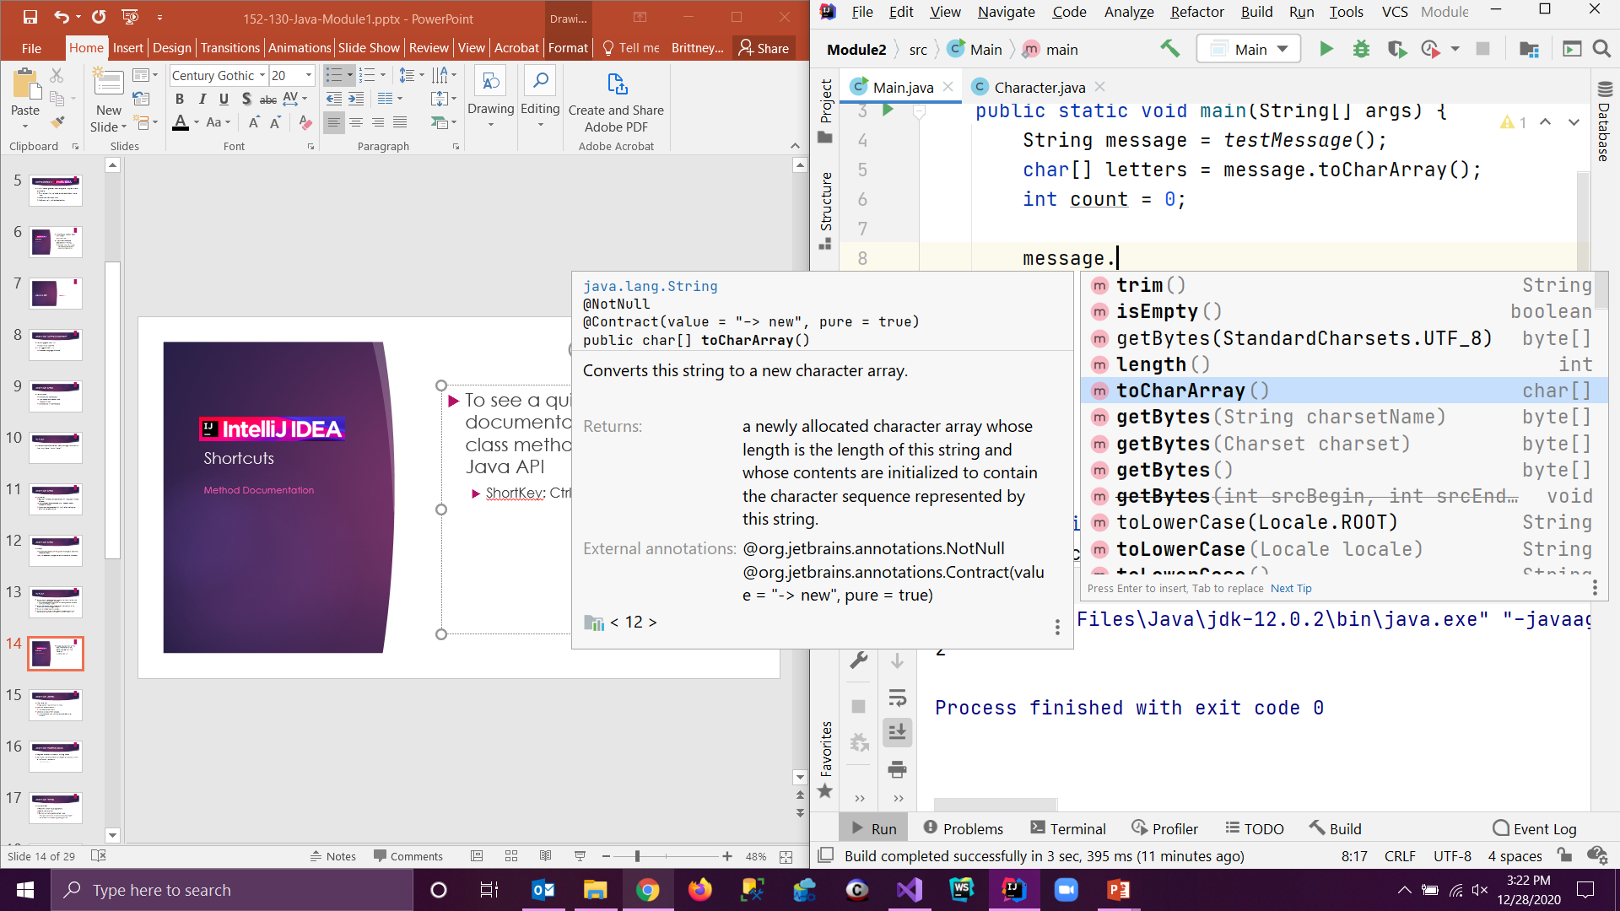
Shortcuts
To see a quick view of the documentation of any class method from the Java API while scrolling through them
ShortKey: Ctrl + Q
Method Documentation

Slide 19
Java vs C#: Syntax
Arrays
Can be declared with the [] after the data type or after the identifier
This allows you to declare multiple variables of the same data type in one statement with the option of some variables being arrays
In C#, they can only be immediately after the data type
Built-in constant length returns the size of the array

Slide 20
Try It Out!
Create an integer constant called SIZE that is initialized to 25
Create a character array called letters initialized with a length of SIZE
Assign letters all of the characters in the message variable
Hint: use a built-in String method to convert message into a character array
Update your for loop to use letters instead of message

Slide 21
Shortcuts
To comment out sections of code, highlight the lines and use the following as a toggle
ShortKey: Ctrl + /
Comment Code

Slide 22
Libraries & Console I/O
Section 2

Slide 23
Java vs C#: Libraries
The Java API
Application Programming Interface
The .NET Framework FCL
Framework Class Library
Libraries of prewritten classes
The classes and their methods are available to all programs

Slide 24
Packages
Classes in the Java API are organized into packages
Groups of related classes
java.io contains input/output classes
java.util contains utilities
Folder hierarchy separated by dots

Slide 25
Packages
Third-party Java classes use their domain name (backwards) as the top-level package
www.wctc.edu
package edu.wctc;
www.indrasoft.com
package com.indrasoft;
tomcat.apache.org
package org.apache.tomcat;

Slide 26
Java vs C#: Importing Classes
You import classes instead of using them
The java.lang package is imported implicitly with every Java project
It contains fundamental classes used in most Java programs

Slide 27
Import Statements
Classes in the java.lang package (like String and System) are automatically available
Everything else must be imported
Imports tell the compiler where to find the class
What if you wrote a class named String or Math?

Slide 28
Explicit vs. Wildcard Imports
Can import a class two ways
Explicit imports a single class
import java.util.Scanner;
Wildcard imports a single package
import java.util.*;

Slide 29
Wildcard Imports
Makes everything in the java.util package available
Not recursive!
Will not import sub-packages like java.util.concurrent or java.util.prefs
Does not affect the size or performance of your program versus explicit imports

Slide 30
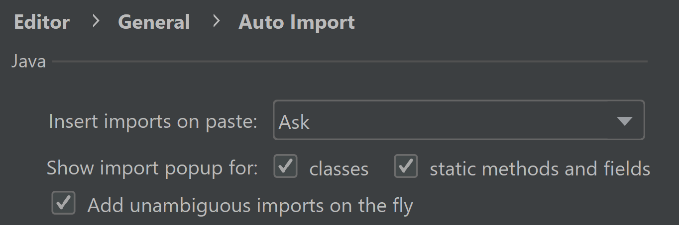
Shortcuts
File > Settings
Editor > General > Auto Import
Under Java, check the box to "Add unambiguous imports on the fly"
Automatically Import Classes

Slide 31
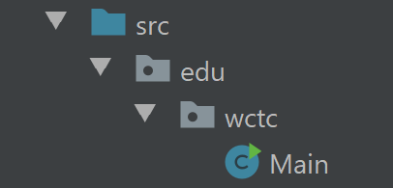
Packages in Your Programs
It is best practice to not create classes in the root package (directly inside the blue src folder)
If you own a domain, you can use it as your package structure
Otherwise, use edu.wctc
Feel free to create additional packages (folders) to organize your classes

Slide 32
Java vs C#: Console I/O
The System class performs system-level operations
Part of the Java API
Contains a static object called out
An open connection to the standard output stream
Methods available to print output data

Slide 33
Java vs C#: Console I/O
System.out.print()
Pronounced "system-dot-out-dot-print"
Displays a value to the standard output
System.out.println()
Displays a value to the standard output
Advances the cursor to the beginning of the next line
System.out.printf()
Displays a value to the standard output
Allows for additional formatting (similar to interpolated strings)

Slide 34
Java vs C#: Format Specifiers
Conversion characters are placeholders for formatted values
%c for chars
%s for strings
%d for integer values (byte, short, int, or long)
%f for floating-point values (float or double)
double num = 123.456;
System.out.printf("The value is %f", num);
>> The value is 123.456000

Slide 35
Java vs C#: Format Specifiers
The general format is:
%[flags][width][.precision]conversion
% – Always start with %
flags – Optional, formatting options
width – Optional, the minimum field width (useful for columns)
.precision – Optional, the number of decimal places to round to
character – The conversion character itself

Slide 36
Java vs C#: Rounding Decimals
Between the % and the conversion character, add a .X
Will round to X decimal places (not truncate)
double temp1 = 72.5555, temp2 = 83.799;
System.out.printf("Temps are %.2f and %.1f degrees.\n", temp1, temp2);
>> Temps are 72.56 and 83.8 degrees.

Slide 37
Java vs C#: Padding Fields
Between the % and the conversion character, add a number X
Will format the value with a minimum field width of X, right justified
Useful for formatting tabular data into columns
double number = 12345.6789;
System.out.printf("The number is: %20f\n", number);
>> The number is: 12345.678900

Slide 38
Java vs C#: Format Flags
Use a comma flag to display numbers with comma separators
double amount = 1234567.89;
System.out.printf("%,f\n", amount);
>> 1,234,567.890000

Slide 39
Java vs C#: Multiple Flags
%08.1f\n
The 0 flag pads numbers with leading zeroes
double number = 123.4;
System.out.printf("The number is: %08.1f\n", number);
>> The number is: 000123.4
pad with zeroes
round to 1 decimal
min field width of 8

Slide 40
Java vs C#: Left Justifying
The - (dash) flag left-justifies a field
int num1 = 123, num2 = 12;
String str1 = "Hello", str2 = "World";
System.out.printf("%-8d%-8s\n", num1, str1);
System.out.printf("%-8s%-8d\n", str2, num2);
>> 123 Hello
>> World 12

Slide 41
Java vs C#: String Interpolation
$ is not supported in Java
Use the printf() method or String.format()
printf() will format the string and output it
String.format() will format the string and return it
System.out.printf("Hello, $s! You are %d.\n", name, age);
String sentence = String.format("Hello, %s! You are %d.", name, age);
System.out.println(sentence);

Slide 42
Java vs C#: Reading Console Input
Scanner class within the java.util package
Can be initialized to read from the standard input (System.in object)
Typically the keyboard
Scanner keyboard = new Scanner(System.in);

Slide 43
Java vs C#: Reading Console Input
Use the Scanner object to assign user input to a variable
System.out.print("Enter a word: ");
String word = keyboard.nextLine();
System.out.println("You entered: " + word);
>> Enter a word: java
>> You entered: java

Slide 44
Java vs C#: Numeric Wrapper Classes
Primitives are simple values with no methods
Every primitive number data type has a corresponding class with utility methods
Called the wrapper classes

Slide 45
Java vs C#: Numeric Wrapper Classes
With the exception of Integer and Character, they look like the primitive, but with a capital first letter (byte → Byte)
They each a contain "parse" method to convert a String to their type

Slide 46
Java vs C#: Numeric Wrapper Classes
String str = "72";
byte bNum = Byte.parseByte(str);
short sNum = Short.parseShort(str);
int iNum = Integer.parseInt(str);
long lNum = Long.parseLong(str);
float fNum = Float.parseFloat(str);
double dNum = Double.parseDouble(str);

Slide 47
Try It Out!
Practice using the three different standard out methods discussed
Print the count variable
Print the found variable
Print the testMessage() return value with another sentence from the standard input stream
Ask the user for a number and store it

Slide 48
Flow Control & Classes
Section 3

Slide 49
Java vs C#: Decision Structures
The if, else if, and else syntax is identical across both languages
The switch statement is identical, except a break statement is not required for each case
Omitting a break will cause a case to fall through into the next

Slide 50
Java vs C#: Repetition Structures
The for, while, and do while loop syntax is also identical
Java contains an enhanced for loop that is similar to the foreach loop in C#

Slide 51
Java vs C#: Enhanced for Loop
List<String> names = new ArrayList<>();
names.add("Mario");
names.add("Luigi");
for(String name : names) {
System.out.println(name);
}
>> Mario
>> Luigi

Slide 52
ArrayList <> Type
Notice on the previous slide that the type of the ArrayList is not required in the angle brackets when initialized
This was required in C#
List<String> names = new ArrayList<>();

Slide 53
ArrayList Variable
Notice also that the ArrayList variable is declared as a List
We will explore this more in Modules 2 and 3
For now know it is best practice in Java
List<String> names = new ArrayList<>();

Slide 54
Try It Out!
Create a method called countUp(int max) that loops from zero to the max value passed to it and prints each value to the console
If the max value is greater than 10, print an error message and exit before looping
If the max value is less than 0, print an error message and exit before looping
Test out your method by calling it from a main method
If you have more time:
Create a method called countDown(int min) that counts down from 10 and test it out
Create a menu to ask the user which method they'd like to choose

Slide 55
Shortcuts
When you begin typing a class that requires an import statement
Before you finish typing the name of the class, press Tab
This will autocomplete the class name and add the necessary import statement
Importing Classes

Slide 56
Try It Out!
Create an ArrayList object to hold a collection of String objects for a To-Do list given by the user
Prompt the user for items until a sentinel is entered
Display the contents of the list using an enhanced for loop
Collections will be covered in depth in Module 3

Slide 57
Java vs C#: Classes
When creating a class, the class name must match the name of the file
public class RaceCar { ... } must be in a file named RaceCar.java
Multiple classes can exist in one file, but only one can be public

Slide 58
Java vs C#: Inheritance
Java class header
public class SubClass extends SuperClass
C# class header
class SubClass : SuperClass
Inheritance will be covered in depth in Module 2

Slide 59
Java vs C#: Inheritance
Java subclass constructor
public SubClass(int value) { super(value); }
C# subclass constructor
public SubClass(int value) : base(value) { }

Slide 60
Unsupported Features
section 4

Slide 61
Unsupported Features: Properties
In C#, there is a shorthand for accessors and mutators called Properties, which also introduced the get and set keywords
This is not supported in Java
Java (for now) requires you to create getter and setter methods

Slide 62
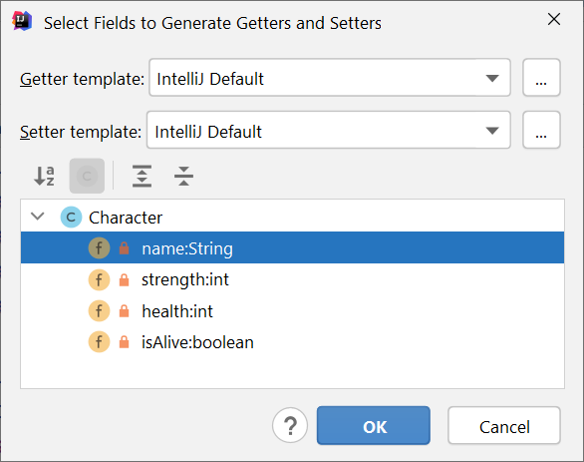
Shortcuts
Create private fields in your class
Right click the class and select Generate > Getters and Setters
Highlight one or more fields
ShortKey: Alt + Insert
Generate Getters and Setters

Slide 63
Try It Out!
Create the Rectangle class from your Intro to C# class and use it in a driver class
Reminder: The class will have private length and width fields

Slide 64
Unsupported Features: Local Functions
In C#, you can create methods within methods
This is not supported in Java
You can use lambda expressions, which is covered in Module 6

Slide 65
Unsupported Features: goto
In C# and its predecessors, you can (but shouldn't) use the goto statement to alter the normal flow of a program and jump to a predefined label
This is not supported in Java, although goto is a reserved keyword
Labels can be used with the branching statements break and continue, which must be used in conjunction with a loop

